Slide 1

FETAL HEALTH PREDICITON
2203A52085-G Sai Krishna Priya
2303A51LB6-K Deepak

Slide 2
INTRODUCTION
Our project is about fetal health prediction. Fetal health is classified in order in to present child and maternal mortality.
Now a days reduction of child mortality is reflecting on severe to the nation’s development and their goals.
Fetal is an unborn offspring and it will be in embryo stage until it comes to world. The main tool which is required to analyse and predict the fetal health in the womb is by CTG(cardiotacography).
CTG not only predicts fetal health but also evaluate heart beat and the contractions in uterus.
By using this CTG it is more easy for the doctor to analyse the health condition of the women. We can easily generate data used by the doctor through CTG.
Hence the doctors are not reliable to analyse data, hence we use different machine learning algorithms to predict fetal health and to analyse data based on it.
Around 700 women die every year in the country as a result of pregnancy complications.

Slide 3
DATASET
Our database fetal health contains 2127 rows and 22 columns.
The values in the dataset are different from one another and this approach can be used by applying some principles on dataset in order to predict fetal health with prime focus on accuracy.
To know fetal health there are more features used in the dataset like histogram mean, histogram median, accelerations, baseline values, fetal moments etc…
The UN expects that by 2030, countries and preventable deaths of newborns and children under 5 years of age , with all countries aiming to reduce under‑5 mortality to at least as low as 25 per 1,000 live births.

Slide 4
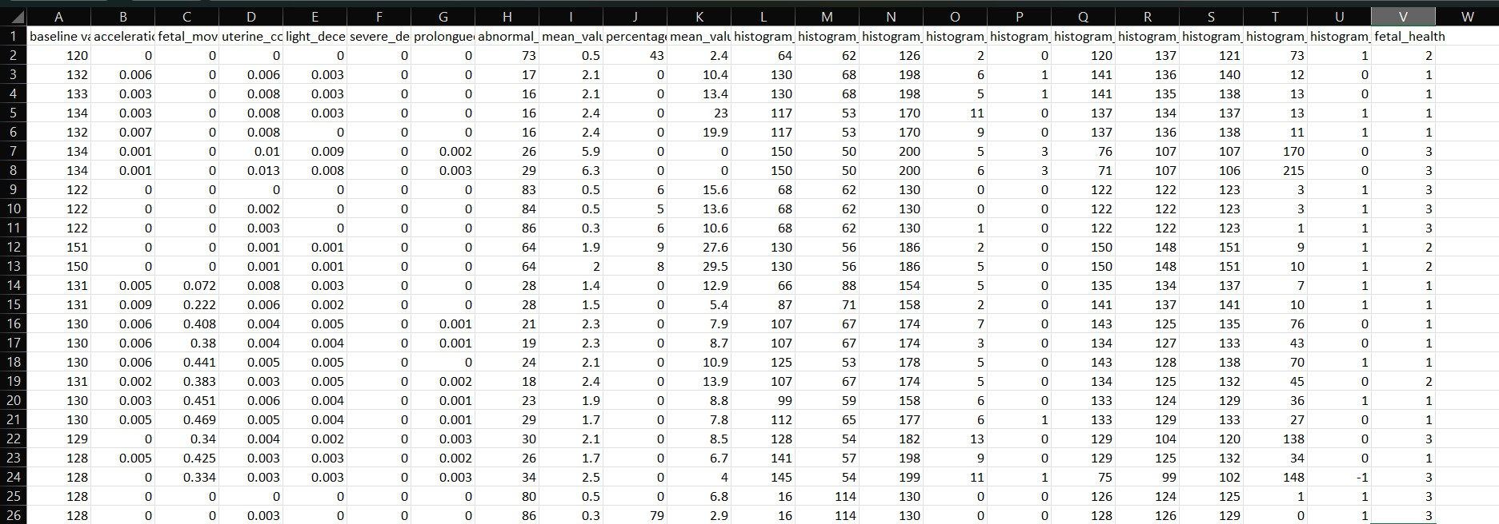
DATASET

Slide 5
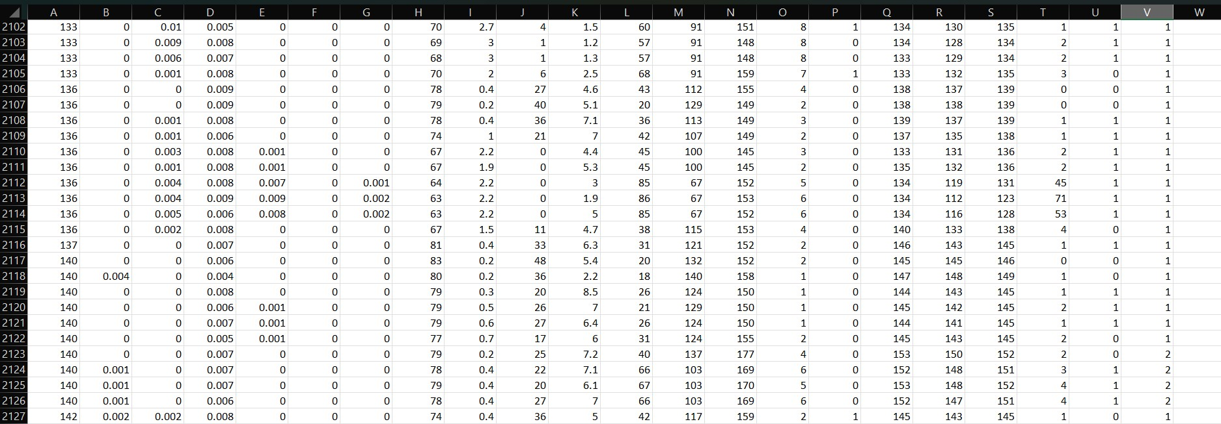

Slide 6
INDEPENDENT VALUES

Slide 7
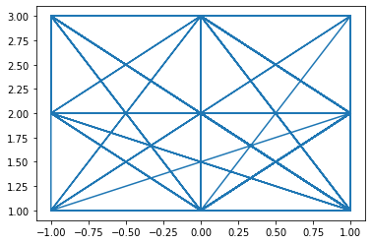
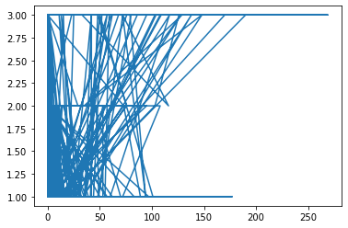
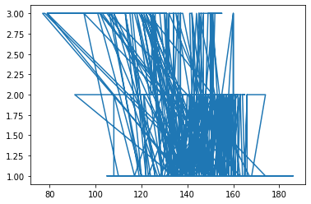
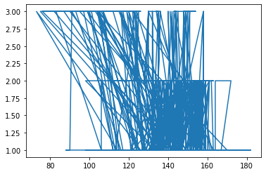
GRAPHS
F
E
T
A
L
H
E
A
L
T
H
F
E
T
A
L
H
E
A
L
T
H
Histogram tendency
Histogram variance
F
E
T
A
L
H
E
A
L
T
H
F
E
T
A
L
H
E
A
L
T
H
Histogram median
Histogram mean

Slide 8
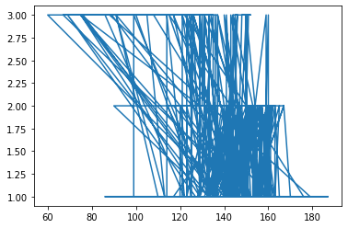
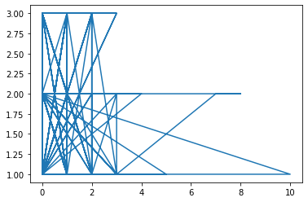
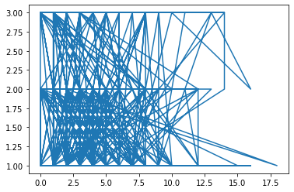
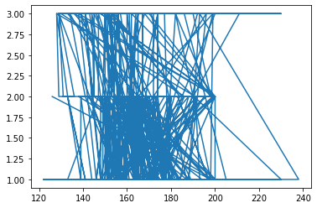
F
E
T
A
L
H
E
A
L
T
H
F
E
T
A
L
H
E
A
L
T
H
Histogram mode
Histogram number of zeros
F
E
T
A
L
H
E
A
L
T
H
F
E
T
A
L
H
E
A
L
T
H
Histogram number of peaks
Histogram max

Slide 9
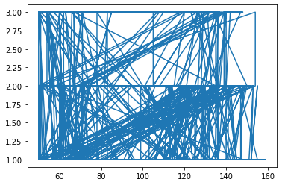
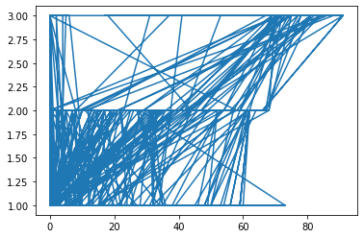
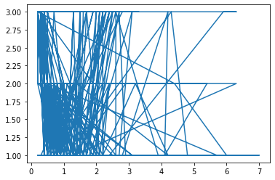
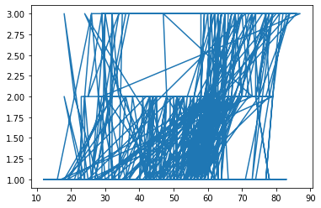
F
E
T
A
L
H
E
A
L
T
H
F
E
T
A
L
H
E
A
L
T
H
Histogram min
Percentage of time with abnormal long term variability
F
E
T
A
L
H
E
A
L
T
H
F
E
T
A
L
H
E
A
L
T
H
Mean value of short term variability
Abnormal short term variablity

Slide 10
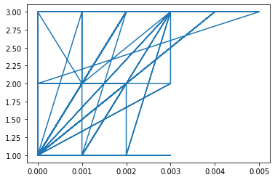
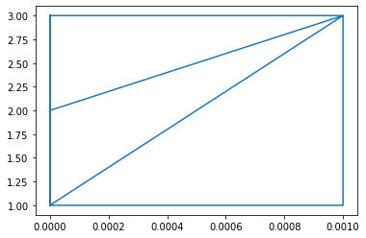
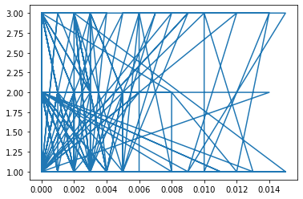
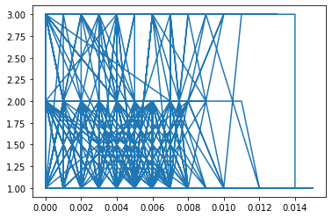
F
E
T
A
L
H
E
A
L
T
H
F
E
T
A
L
H
E
A
L
T
H
Prolonged decelerations
Severe decelerations
F
E
T
A
L
H
E
A
L
T
H
F
E
T
A
L
H
E
A
L
T
H
Light decelerations
Aterine contractions

Slide 11
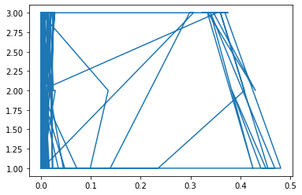
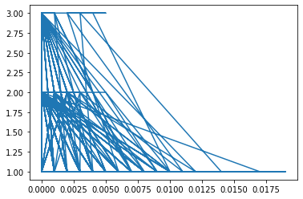
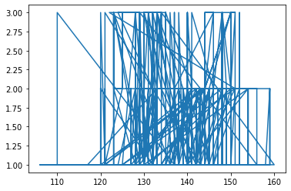
F
E
T
A
L
H
E
A
L
T
H
F
E
T
A
L
H
E
A
L
T
H
Fetal movement
Accelerations
F
E
T
A
L
H
E
A
L
T
H
Baseline values

Slide 12
CONCLUSION
At the end of this end we will be able to predict the health of the fetus with a higher accuracy rate.
According to source around 6 babies per 1000 babies was the fetal mortality rate in the year 2022.
Fetal rate can be reduced by knowing the fetal health and by taking necessary precautions.
Health complications during pregnancy time constitute a significant challenge for women.
Malnutrition among mothers, food habits and some of the diseases are common health issues that affect the development of the fetus.
This work assesses the influence of various factors measured through CTG to predict the health state of the fetus.
The research work will be helpful for the doctors in making timely decisions to save the life of both mother and child.

Slide 13
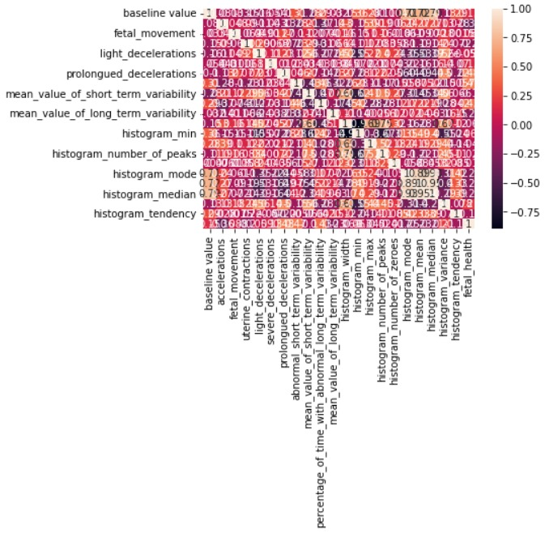
CORRELATION MATRIX

Slide 14
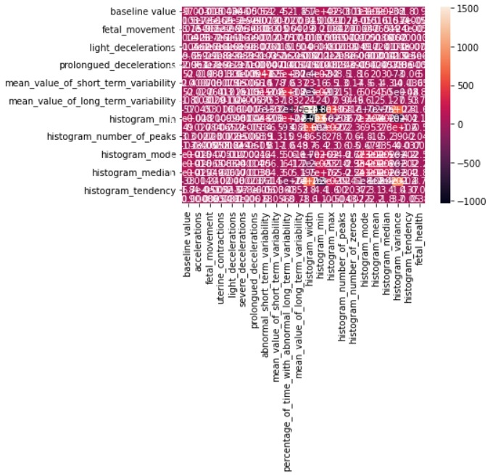
COVARIANCE MATRIX

